Slide 2
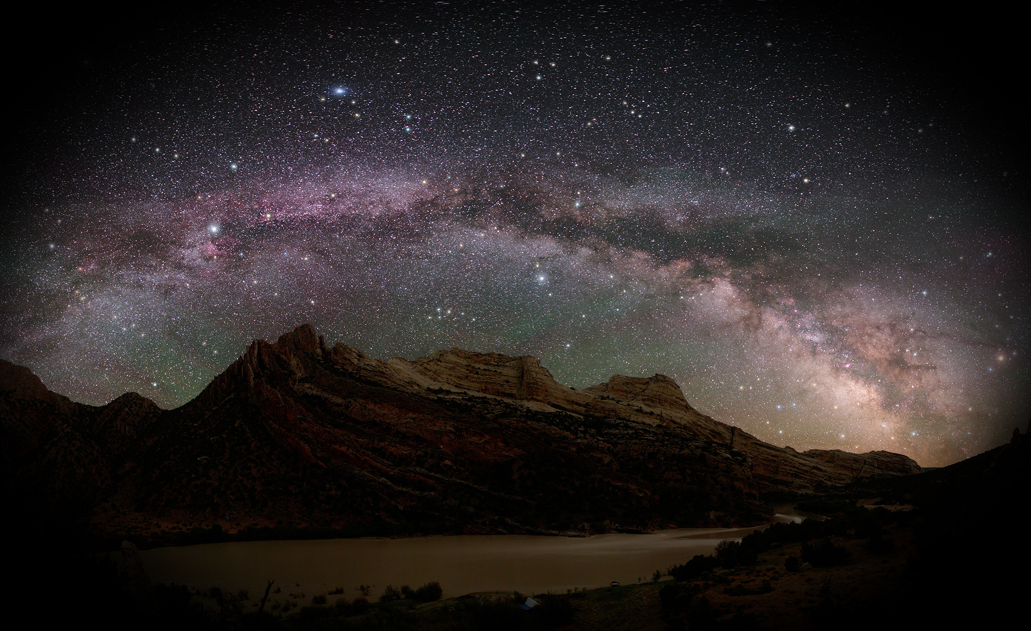
Open the eyes of my heart Lord
Open the eyes of my heart
I want to see you,
I want to see you.

Slide 3
Open the eyes of my heart Lord
Open the eyes of my heart
I want to see you,
I want to see you.

Slide 4
To see you high and lifted up
Shining in the light of your glory
Pour out your power and love
As we sing holy, holy, holy

Slide 5
Holy, holy, holy
Holy, holy, holy
Holy, holy, holy
I want to see you

Slide 6
Holy, holy, holy
Holy, holy, holy
Holy, holy, holy
I want to see you

Slide 7
To see you high and lifted up
Shining in the light of your glory
Pour out your power and love
As we sing holy, holy, holy

Slide 8
Holy, holy, holy
Holy, holy, holy
Holy, holy, holy
I want to see you

Slide 9
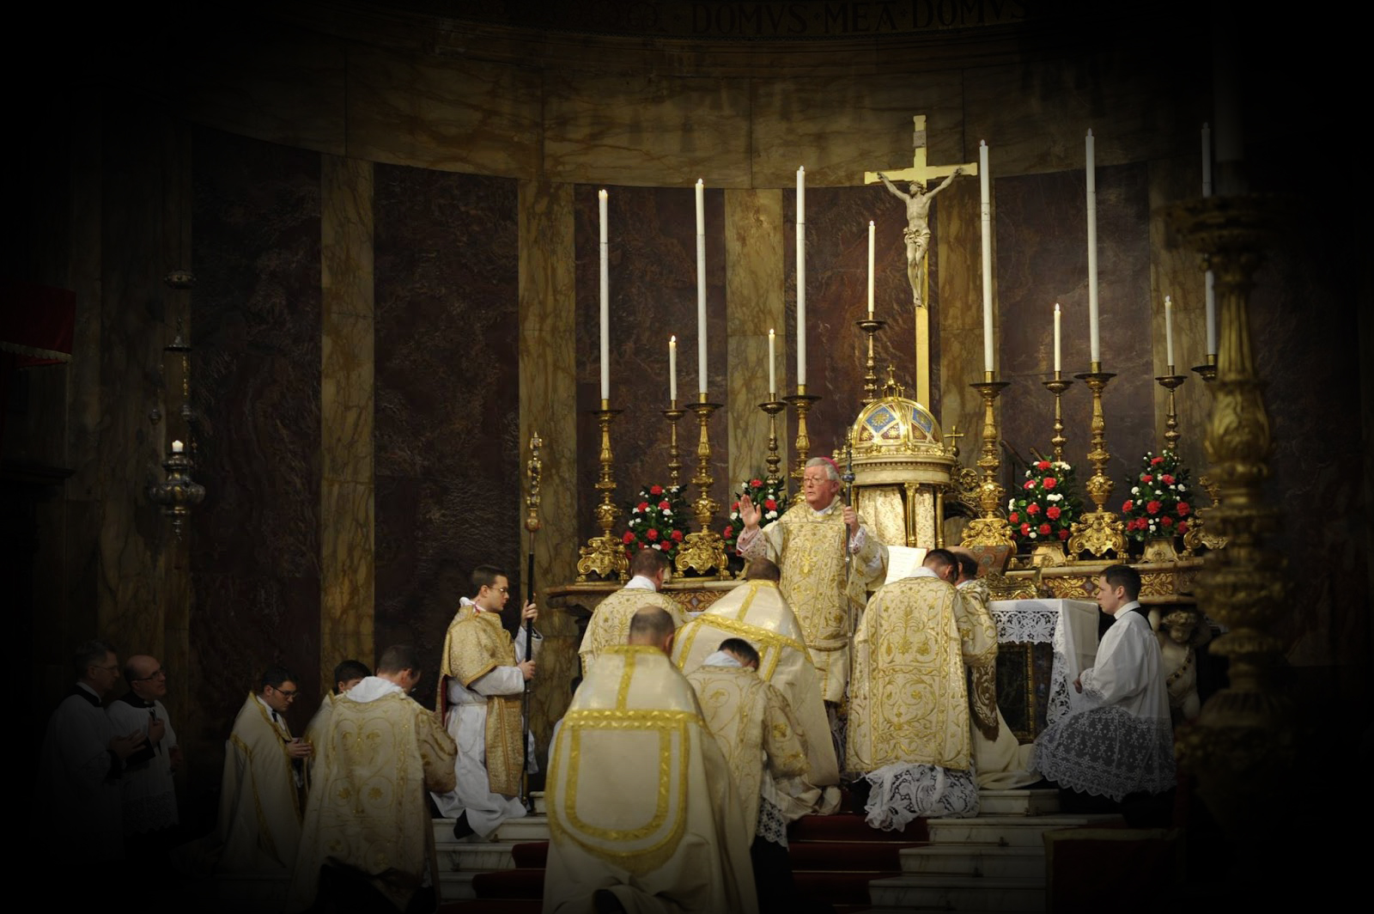
Hallelujah!
Praise God in his holy sanctuary;
give praise in the mighty dome of heaven.
Give praise for his mighty deeds,
praise him for his great majesty.
Give praise with blasts upon the horn,
praise him with harp and lyre.
Give praise with tambourines and dance,
praise him with strings and pipes.
Give praise with crashing cymbals,
praise him with sounding cymbals.
Let everything that has breath
give praise to the LORD!
Hallelujah!
Psalm 150
Hallelujah!
Praise God in his holy sanctuary;
give praise in the mighty dome of heaven.
Give praise for his mighty deeds,
praise him for his great majesty.
Give praise with blasts upon the horn,
praise him with harp and lyre.
Give praise with tambourines and dance,
praise him with strings and pipes.
Give praise with crashing cymbals,
praise him with sounding cymbals.
Let everything that has breath
give praise to the LORD!
Hallelujah!
Psalm 150

Slide 10
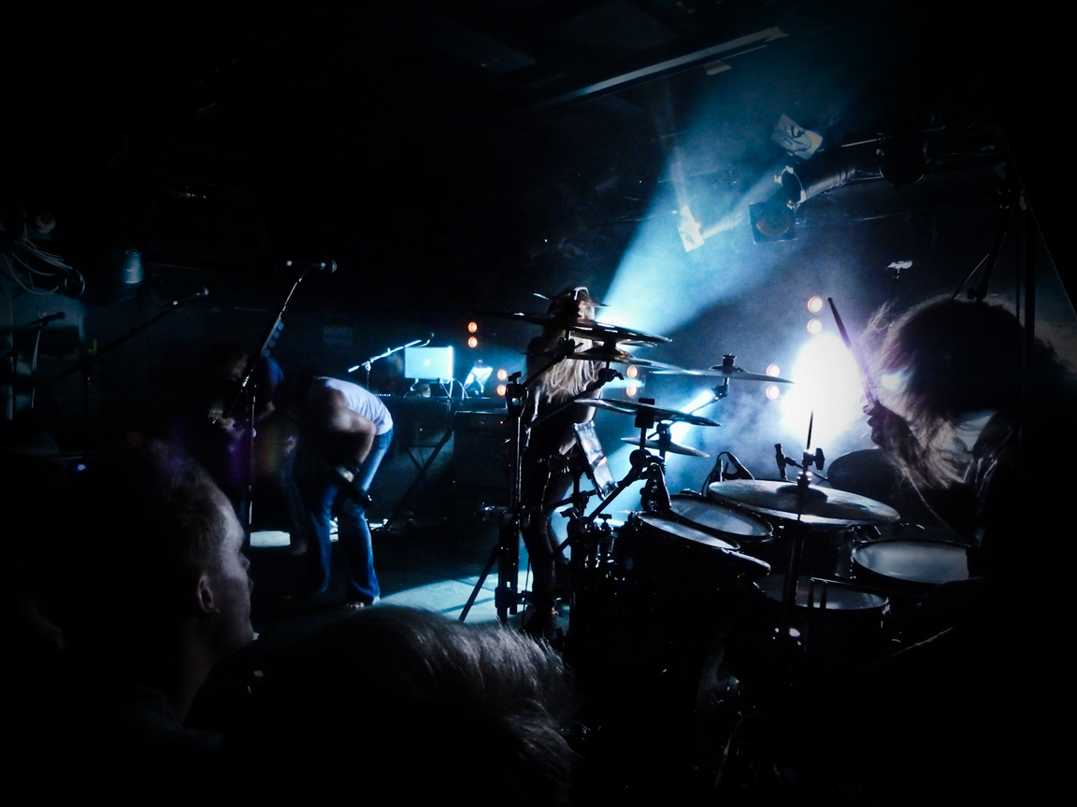
Then according to the Bible,
drums, guitars and cymbals are
Actually Required for worship!

Slide 11
“The musical tradition of the universal Church is a treasure of inestimable value, greater even than that of any other art. The main reason for this pre-eminence is that, as a combination of sacred music and words, it forms a necessary or integral part of solemn liturgy. ” The composition and singing of inspired psalms, often accompanied by musical instruments, were already closely linked to the liturgical celebrations of the Old Covenant. The Church continues and develops this tradition: “Address... one another in psalms and hymns and spiritual songs, singing and making melody to the Lord with all your heart.” “He who sings, prays twice.” Catechism of the Catholic Church 1156

Slide 12
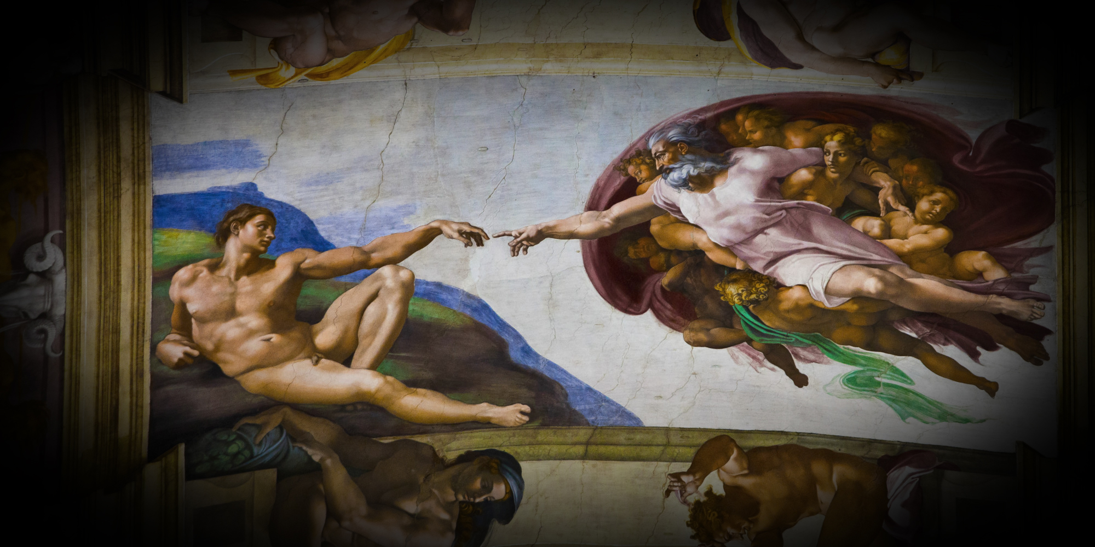
…greater even than that of any…

Slide 13
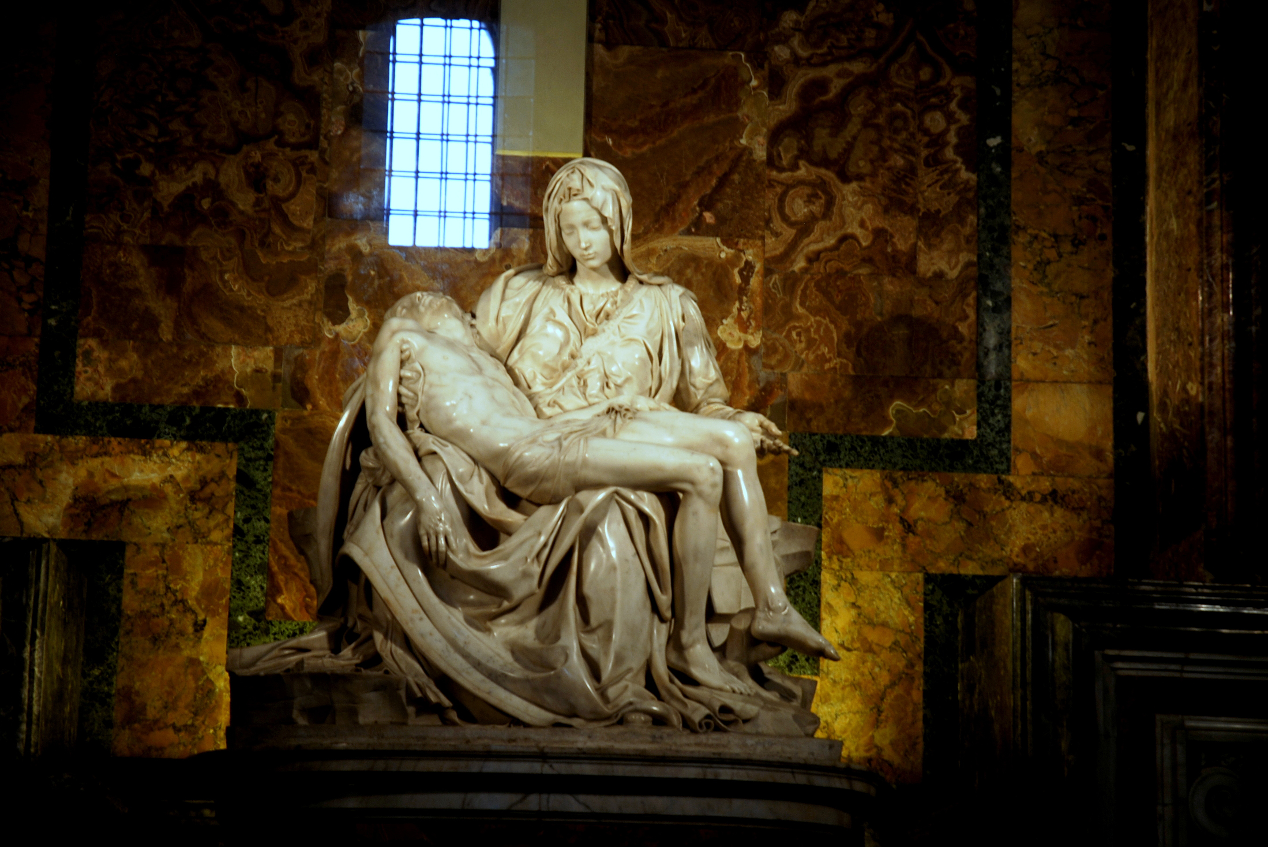
…other…

Slide 14
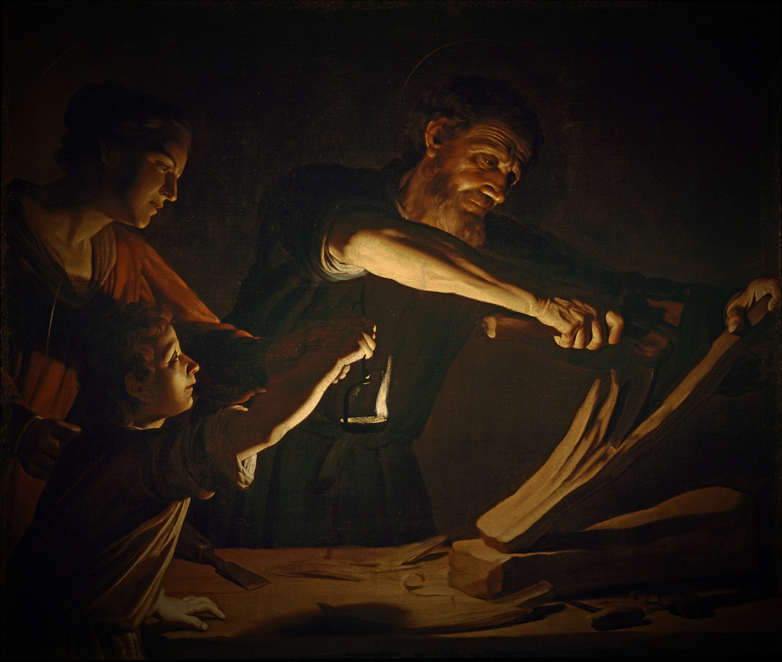
…art.

Slide 15
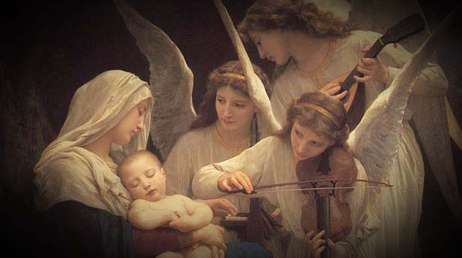
…Heavenly Music.

Slide 16
St. Augustine wrote in his commentary on Psalm 73:
"For he that singeth praise, not only praiseth, but also praiseth with gladness: he that singeth praise, not only singeth, but also loveth him of whom he singeth. In praise, there is the speaking forth of one confessing; in singing, the affection of one loving."
Or
He who sings, prays twice!

Slide 17
Gathering Song
Gloria
The Psalm
Gospel Acclamation
Preparation Hymn
The Holy, Holy
The Proclamation of Faith
The Great Amen
The Lords Prayer (sometimes sung)
The Lamb of God
First communion Song
Second communion Song (depending upon time)
Song of Thanksgiving

Slide 18
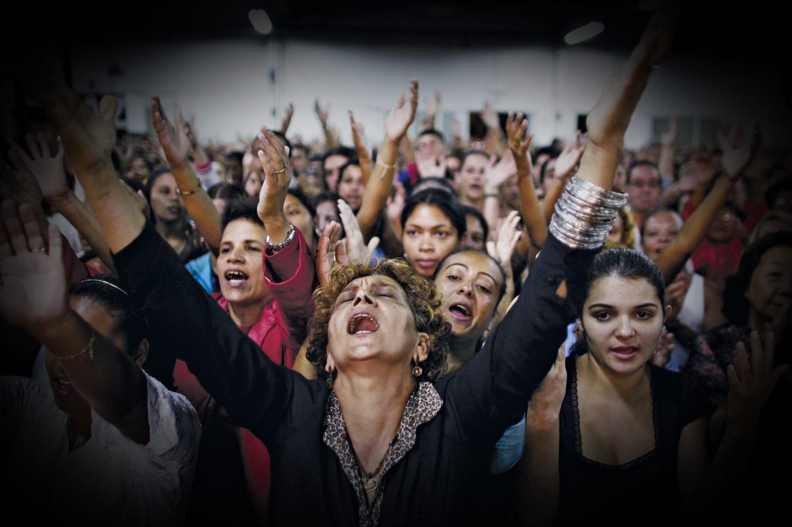
If you have a beautiful voice
Sing out in praise

Slide 19
If you have a beautiful voice
Sing out in praise
If you have a horrible voice
Sing out in revenge

Slide 20
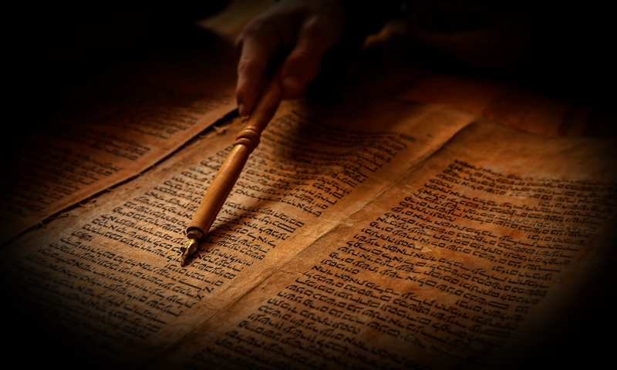
Music, Song or Singing is mentioned
in the scriptures 345 times
I think God loves music!

Slide 21
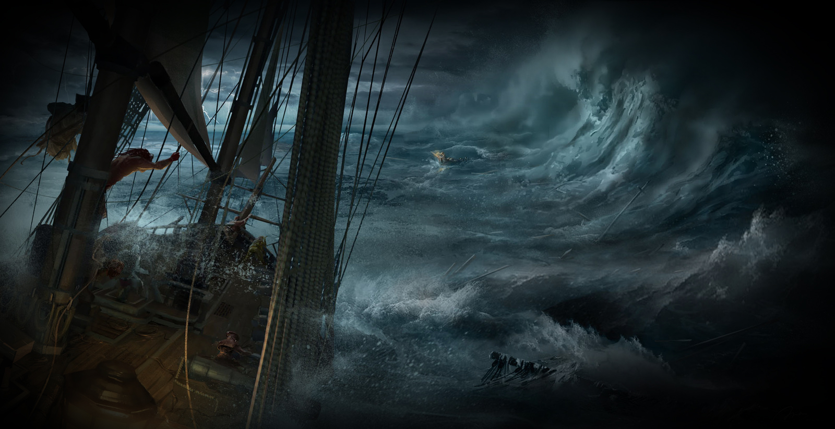
The Idea of Prayer as Music.
Amazing Grace

Slide 22
Amazing Grace
Amazing grace! How sweet the sound
That saved a wretch like me!
I once was lost, but now am found;
Was blind, but now I see.
’Twas grace that taught my heart to fear,
And grace my fears relieved;
How precious did that grace appear
The hour I first believed.

Slide 23
Amazing Grace
Yea, when this flesh and heart shall fail,
And mortal life shall cease,
I shall possess, within the veil,
A life of joy and peace.
The earth shall soon dissolve like snow,
The sun forbear to shine;
But God, Who called me here below,
Shall be forever mine.

Slide 24
Let us Pray…

Slide 25
Open the eyes of my heart Lord
Open the eyes of my heart
I want to see you,
I want to see you.

Slide 26
To see you high and lifted up
Shining in the light of your glory
Pour out your power and love
As we sing holy, holy, holy

Slide 27
Holy, holy, holy
Holy, holy, holy
Holy, holy, holy
I want to see you

Slide 28
Holy, holy, holy
Open the eyes of my heart Lord
Holy, holy, holy
Open the eyes of my heart
Holy, holy, holy
I want to see you
I want to see you
I want to see you

Slide 29
To see you high and lifted up
Shining in the light of your glory
Pour out your power and love
As we sing holy, holy, holy

Slide 30
Holy, holy, holy
Open the eyes of my heart Lord
Holy, holy, holy
Open the eyes of my heart
Holy, holy, holy
I want to see you
I want to see you
I want to see you

Slide 31
Lord I Need You
Lord I come, I confess
Bowing here, I find my rest
Without you, I fall apart
You’re the one, that guides my heart
Lord I need you, oh I need you
Every hour I need you
My one defemnse, my righteousness
Oh God, how I need you

Slide 32
Where sin runs deep, Your grace is more
Where grace is found, is where You are
And where You are, Lord I am free
Holiness is Christ in me.
Lord I need you, oh I need you
Every hour I need you
My one defense, my righteousness
Oh God, how I need you

Slide 33
So teach my song to rise to you
When temptation comes my way
And when I cannot stand I’ll fall on you
Jesus you’re my hope and stay
Lord I need you, oh I need you
Every hour I need you
My one defemnse, my righteousness
Oh God, how I need you

Slide 34
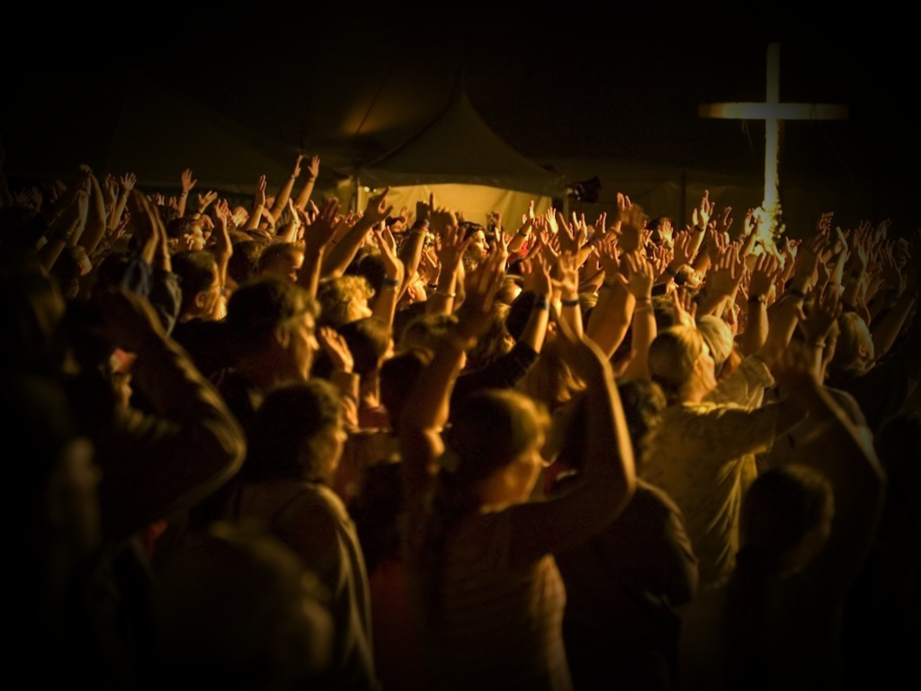
Sing to the Lord a new song;
sing to the Lord, all the earth.
Sing to the Lord, bless his name;
proclaim his salvation day after day.
Tell his glory among the nations;
among all peoples, his marvelous deeds.
...Psalm 96

